Slide 1
Chapter 3 Dynamic Programming

Slide 2
Dynamic Programming
Design technique, like Divide-and-conquer
Divide-and-conquer: Divide the problem into independent subproblems. Solve the subproblems recursively and combine the results.
Dynamic Programming: when the subproblems are not independent.

Slide 3
Fibonacci series
The subproblems are not independent recursively
1 n=0
F(n)= 1 n=1
F(n-1)+F(n-2) n>1
F(4)
F(3)
F(2)
F(2)
F(1)
F(1)
F(0)
F(1)
F(0)

Slide 4
a divide-and-conquer algorithm does more work than necessary, repeatedly solving the common subsubproblems.
A dynamic-programming algorithm solves every subsubproblem just once and then saves its answer in a table, thereby avoiding the work of recomputing the answer every time the subsubproblem is encountered.

Slide 5
It is typically applied to optimization problems
The development of a dynamic-programming algorithm can be broken into a sequence of four steps.
1 Characterize the structure of an optimal solution.
2 Recursively define the value of an optimal solution.
3 Compute the value of an optimal solution in a bottom-up fashion.
4 Construct an optimal solution from computed information.
Notes:
In such problems there can be many possible solutions. Each solution has a value, and we wish to find a solution with the optimal (minimum or maximum) value. We call such a solution an optimal solution to the problem, as opposed to the optimal solution, since there may be several solutions that achieve the optimal value.

Slide 6

Matrix-chain Multiplication矩阵连乘问题
Hallmarks动态规划算法的基本
Job scheduling流水作业调度
0-1 knapsack problem背包问题
Optimal Binary Search Tree最优二叉搜索树

Slide 7
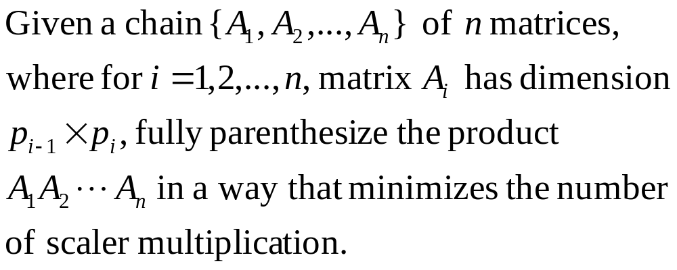
Matrix-chain Multiplication
给定n个矩阵{A₁, A₂, …, A_{n}}，其中A_{i} 是一个p_{i-1}×r_{i} 矩阵( 1≤i≤n)，即A_{i}×A_{i+1}是可乘的，求出n个矩阵相乘的最优计算次序，使得计算量最小。

Slide 8
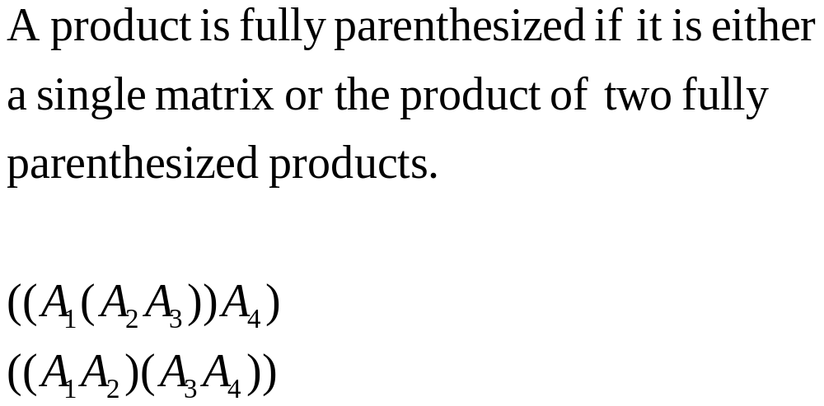
Fully Parenthesize

Slide 9
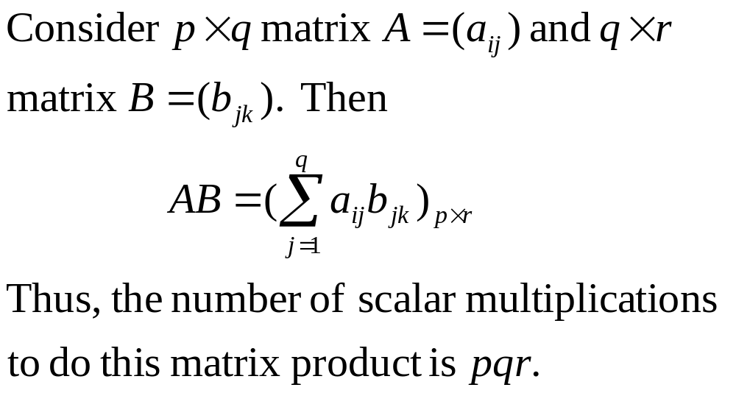
Scalar Multiplications

Slide 10
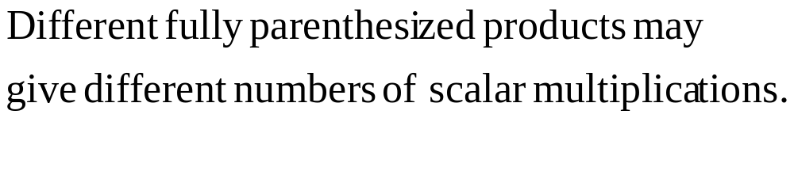
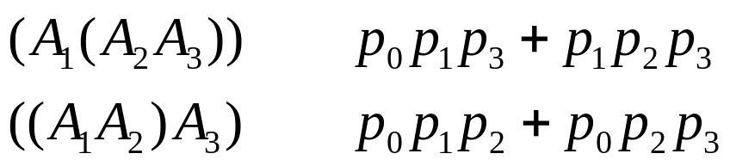
e.g.,
# of scalar multiplications
A₁, A₂, A₃大小分别为10×100，100×5，5×50， (A₁( A₂ A₃)), (A₁A₂) A₃)的结果相同，都是10×50的矩阵，计算量分别为75000，7500

Slide 11
Two matrix multiplication
void MatrixMultiply(int **a, int **b, int **c, int ra, int ca, int rb, int cb)
{
if(ca! = rb ) error(“矩阵不可乘”)；
for(int i = 0; i < ra; i ++)
for(int j = 0; j < cb; j ++){
int sum = a[i][0]* b[0][j];
for(int k = 1; k < ca; k ++)
sum + = a[i][k]* b[k][j];
c[i][j] = sum;
}
}

Slide 12
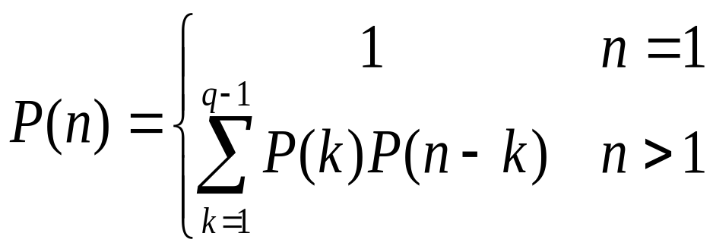
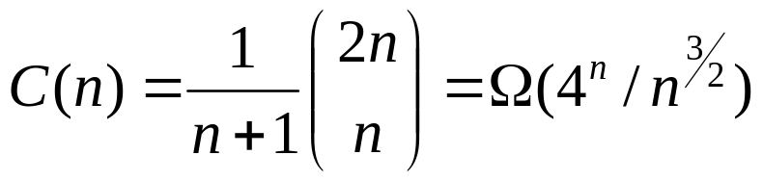
brute force 穷举搜索法
矩阵连乘问题
对于n个矩阵的连乘积，设有p(n)个计算次序。我们可以在第k个和第k＋1个矩阵之间将原矩阵划分为两个子矩阵序列，然后分别对这两个矩阵子序列完全加括号，最后对所得的结果加括号，则
其中P(n)=C(n-1)，

Slide 13
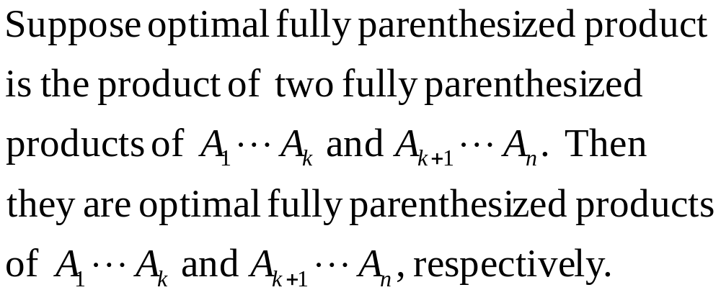
Step 1. Find recursive structure of
optimal solution
分析最优解的结构

Slide 14
Optimal structure
If one optimal solution of A[1:n] is A[1:k] and A[k+1:n]
Then A[1:k] and A[k+1:n] are optimal for their subproblem.
考虑A[1:k ]和A[k+1:n]相乘所需的计算量，A[ i: k ]和A[ k+1:j ]相乘呢
A[1:k ]的结果为r₀*r_{k}的矩阵，A[k+1:n]的结果为r_{k}*r_{n}的矩阵，则它们相乘的计算量为p₀*p_{k}*p_{n}

Slide 15
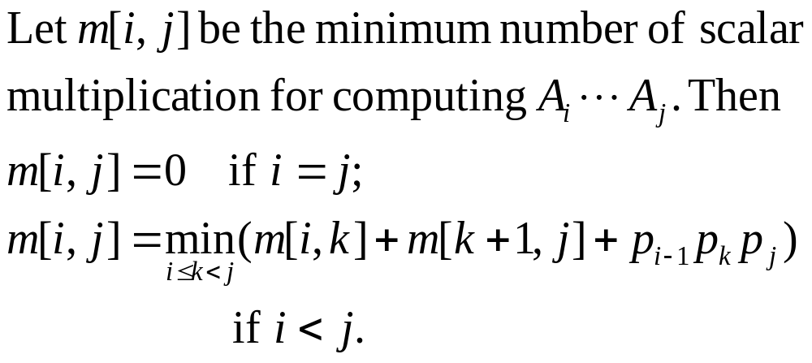
Step 2. Build recursive formula about
optimal value

Slide 16
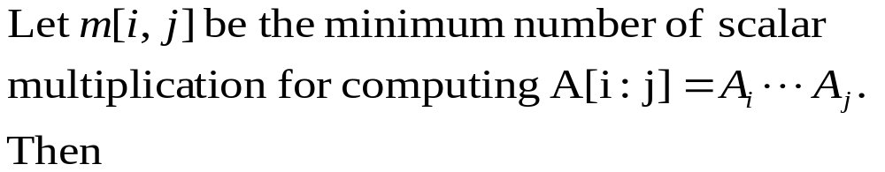
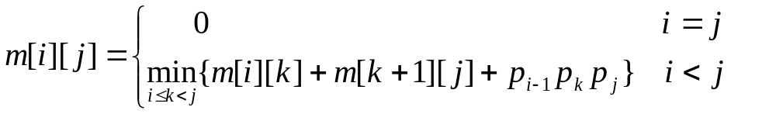
Step 2. Build recursive formula about optimal value
i = j , A[ i : j ]= A_{i} , m[ i ][ i ] = 0,i=1,2,···,n.
i < j, m[ i ][ j ]=m[ i ][ k ] + m[ k+1 ][ j ] + p_{i-1}p_{k}p_{j}
k∈ { i, i+1, ···, j-1 }

Slide 17
Recursive Computing
取第一个断开位置时计算量
参加运算矩阵链起始位置
矩阵链终止位置
int RecurMatrixChain( int i, int, j, int p[])
{
if ( ) return 0;
int u=RecurMatrixChain(i, i)+RecurMatrixChain(i+1,j,p)
+p[i-1]*p[i]*p[j];
s[i][j]=i;
for(int k=i+1; k<j; k++){
int t=RecurMatrixChain(i,k)+RecurMatrixChain(k+1,j,p)
+p[i-1]*p[i]*p[j];
if (t<u) {
u=t;
s[i][j]=k;}
}
return u;
}
i==j
记录当前断开位置
循环取k的可取断开位置

Slide 18
Recursive tree
1······4
1······1
2······4
1······2
3······4
1······3
4······4
2······2
3······4
2······3
4······4
1······1
2······2
3······3
4······4
1······1
2······3
1······2
3······3
3······3
4······4
2······2
3······3
2······2
3······3
1······1
2······2

Slide 19
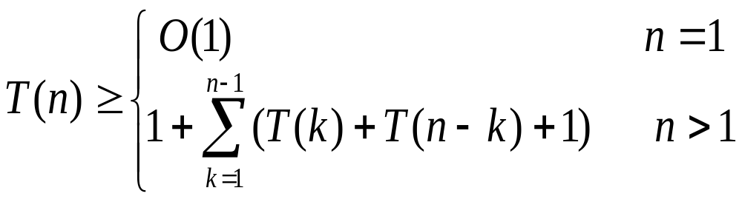
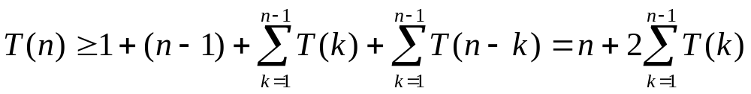
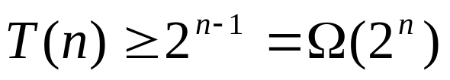
When n>1
We can got

Slide 20
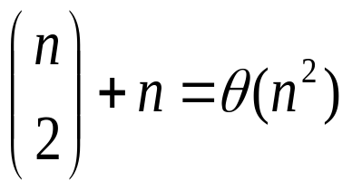
For 1≤i ≤j ≤n, different pair (i,j) correspond to different subproblem m[i][j]. So, the number of different subproblem is :
用动态规划解此问题时，在计算过程中，保存已解决的子问题答案，每个子问题只计算一次，而在后面用到时简单地查一下，从而避免了大量的重复计算

Slide 21
Step 3. Computing optimal value
1······4
2······4
1······3
1······2
2······3
3······4
1······1
2······2
3······3
4······4

Slide 22
Step 3. Computing optimal value
Only use m[ i ][ k ] and m[ k+1 ][ j ] to compute m[ i ][ j ]
m[1][2] m[2][3] m[3][4] m[4][5] …… m[n-1][n]
m[1][3] m[2][4] m[3][5] …… m[n-2][n]
m[1][4] m[2][5] m[3][6]…… m[n-3][n]
m[1][n-1] m[2][n]
m[1][n]

Slide 23
Step 3. Computing optimal value
Only use m[ i ][ k ] and m[ k+1 ][ j ] to compute m[ i ][ j ]
m[i][i]=0， i=1,2,···,n. The length of matrix length is 1.
We can get the optimal value of matrix chain with the length of 2
Length of 3
………………………………

Slide 24
example
Compute A₁A₂A₃A₄A₅A_{6 .} The dimension of them are :
A₁ A₂ A₃ A₄ A₅ A₆
30×35 35×15 15×5 5×10 10×20 20×25
j
1 2 3 4 5 6
i
0
15750
7875
9375
11875
15125
0
2625
4375
7125
10500
0
750
2500
5375
0
1000
3500
0
5000
0
m[1][1] + m[2][3]+p0p1p3=7875
m[1][3]=min
m[1][2] + m[3][3] + p0p2p3=15750

Slide 25
Step 3. Computing optimal value
void MatrixChain(int p, int n, int * *m, int * *s)
{
for (int i=1; i<=n; i++) m[i][i]= ;//单个矩阵的计算量
for (int r=2; r<=n; r++){//r为每次循环矩阵链的长度
for (int i=1; i<= ; i++)
int j=i+r-1;
m[i][j]= m[i+1][j]+p[i-1]*p[i]*p[j];
s[i][j]=i;
for (int k=i+1; k<j; k++){
int t= m[i][k]+ m[k+1][j]+ ;
if (t< m[i][j]) {
m[i][j]=t;
s[i][j]=k; }
}
}
}
0
n – r + 1
取第一个可取位置，即断开位置为i
循环取k的可取位置
p[i-1]*p[k]*p[j]

Slide 26
process
m[i][i]=0, i=1,2,···,n,
m[i][i+1],i=1,2,···,n-1(length of 2)；m[i][i+2],i=1,2,···,n-2,(length of 3)；
Compute order
m[1][1],m[2][2],m[3][3]….m[n][n]
m[1][2],m[2][3],m[3][4]····m[n-1][n]
m[1][3],m[2][4],m[3][5]····m[n-2][n]
·····
m[1][n-1],m[2][n]
m[1][n]

Slide 27
Compute complexity
MatrixChain has three loops. Compute complexity of every loop is O(n).
O(n³)

Slide 28
Step 4. Constructing an optimal solution
it does not directly show how to multiply the matrices.
Should get the optimal solution s[i][j]. If s[i][j]=k, then the optimal solution of A[i:j] is (A[i:k])(A[k+1:j])。

Slide 29
1 2 3 4 5 6
0 1 1 3 3 3
0 2 3 3 3
0 3 3 3
0 4 5
0 5
0
Consider A[1][6]
S[1][1]=0
S[1][3]
S[2][3]=0
S[2][2]= S[3][3]= 0
S[1][6]
A₁(A₂A₃)
A₁((A₂)(A₃))
(A₁…A₃) (A₄…A₆)
S[4][6]
S[6][6]=0
S[4][4]= S[5][5]= 0
(A₄A₅) A₆
S[4][5]=0
((A₄)(A₅)) A₆

Slide 30
Step 4. Constructing an optimal
solution
Void Traceback(int i, int j, int * * s)
{
if (i==j) return;
Traceback(i, s[i][j], s);
Traceback(s[i][j]+1, j, s);
cout << “Multiply A” << i << “,” << s[i][j];
cout << “and A” << (s[i][j] +1) << “,” << j; << endl;
}
Invoke Traceback(1, n, s)

Slide 31
作业
1 当A₁ A₂ A₃ A₄ 分别为20×25， 25×10，10×5，5×15的矩阵时，填写相应的m[i][j]和s[i][j]，并给出最优计算次序。

Slide 32
Elements of dynamic programming
1 Optimal substructure最优子结构性质
2 Overlapping subproblems重叠子问题性质

Slide 33
Optimal substructure
Recall that a problem exhibits optimal substructure if an optimal solution to the problem contains within it optimal solutions to subproblems.

Slide 34
discovering optimal substructure
1. You show that a solution to the problem consists of making a choice, such as choosing an index at which to split the matrix chain. Making this choice leaves one or more subproblems to be solved.
2. You suppose that for a given problem, you are given the choice that leads to an optimal solution
3. Given this choice, you determine which subproblems ensue and how to best characterize the resulting space of subproblems.

Slide 35
discovering optimal substructure
4. You show that the solutions to the subproblems used within an optimal solution to the problem must themselves be optimal by using a “cut-and-paste” technique.You do so by supposing that each of the subproblem solutions is not optimal and then deriving a contradiction. In particular, by “cutting out” the nonoptimal solution to each subproblem and “pasting in” the optimal one, you show that you can get a better solution to the original problem, thus contradicting your supposition that you already had an optimal solution. If an optimal solution gives rise to more than one subproblem, they are typically so similar that you can modify the cut-and-paste argument for one to apply to the others with little effort.

Slide 36
Overlapping subproblems
The second ingredient is that the space of subproblems must be “small” in the sense that a recursive algorithm for the problem solves the same subproblems over and over, rather than always generating new subproblems.

Slide 37
Overlapping subproblems
MATRIX-CHAIN-ORDER repeatedly looks up the solution to subproblems in lower rows when solving subproblems in higher rows.
For example, it references entry m[3; 4] four times: during the computations of m[2; 4], m[1; 4], m[3,5] , m[3,6]

Slide 38
Memoization(备忘录方法)
The idea is to memoize the natural, but inefficient, recursive algorithm.
As in the bottom-up approach, we maintain a table with subproblem solutions, but the control structure for filling in the table is more like the recursive algorithm.
Each table entry initially contains a special value to indicate that the entry has yet to be filled in. When the subproblem is first encountered as the recursive algorithm unfolds, its solution is computed and then stored in the table. Each subsequent time that we encounter this subproblem, we simply look up the value stored in the tab

Slide 39
memoized version of RECURSIVE-MATRIX-CHAIN
int MemoizedMatrixChain(int n,int **m,int **s)
{
for(int i=1;i<=n;i++)
for(int j=i;j<=n;j++)
m[i][j]=0;
return LookupChain(1,n);
}

Slide 40
动态规划算法的基本要素
int LookupChain(int i, int j)
{
if(m[i][j]>0) return m[i][j];
if(i==j) return 0;
int u=LookupChain(i,i)+LookupChain(i+1,j)
+p[i-1]*p[k]*p[j];
s[i][j]=i;
for(int k=i+1;k<j;k++){
int t=LookupChain(i,k)
+LookupChain(k+1,j)
+p[i-1]*p[k]*p[j];
if(t<u){
u=t;
s[i][j]=k;}
}
m[i][j]=u;
return u;
}
表示该子问题已经求解
递归求解断开位置为i时的计算量
循环每个可取断开位置求计算量
作业：
请写出利用备忘录方法计算A[1:4]时都计算了哪些子问题

Slide 41
Whenever a given call of LOOKUP-CHAIN makes recursive calls, it makes O(n) of them. Therefore, there are O(n³) calls of the second type in all. Each call of the second type takes O(1) time, and each call of the first type takes O(n) time plus the time spent in its recursive calls. The total time, therefore, is O(n³).

Slide 42
In general practice, if all subproblems must be solved at least once, a bottom-up dynamic-programming algorithm usually outperforms the corresponding top-down memoized algorithm by a constant factor, because the bottom-up algorithm has no overhead for recursion and less overhead for maintaining the table.
Alternatively, if some subproblems in the subproblem space need not be solved at all, the memoized solution has the advantage of solving only those subproblems that are definitely required.

Slide 43
Applying dynamic programming
1. Characterize the structure of an optimal solution.
2. Recursively define the value of an optimal solution.
3. Compute the value of an optimal solution.
4. Construct an optimal solution from computed information

Slide 44
3.4 0-1 Knapsack Problem
0-1背包问题

Slide 45
Given weights and values of n items, put these items in a knapsack of capacity c to get the maximum total value in the knapsack.
Given weights and values of n items, put these items in a knapsack of capacity c to get the maximum total value in the knapsack.
Given two integer arrays v[ ] and w[ ] which represent values and weights associated with n items respectively. Find another array x[ ] , here x_{i} (x_{i} = 0 or１, x_{i} = 0 represent itemｉis not put in kanpsack. x_{i} ＝1 represents item I is in kanpsack), to get
Max ∑ v_{i}x_{i} .
1≤i ≤ n

Slide 46
example
There are three items:
weights are ( w₁, w₂, w₃ ) = ( 2, 3, 4 ),
values are ( v₁, v₂, v₃ ) = ( 1, 2, 5 ),
Capacity of knapsack c = 6. how to find out the maximum value subset of v[ ].
{x₁, x₂, x₃} = {0, 0, 0} {1, 0, 0} {0, 1, 0} {0, 0, 1} {1, 1, 0} {1, 0, 1}
{x₁, x₂, x₃} = {1, 0, 1}
v₁* x₁ + v₂*x₂ + v₃*x₃= 6

Slide 47
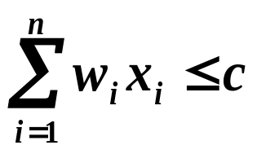
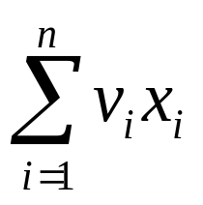

Given c>0, w_{i}>0, v_{i}>0,1≤i≤n, to find out a vector ( x₁, x₂, ···, x_{n} ), x_{i} ∈ {0,1} , 1≤i≤n, which make ，
But is maximum. We use knap(1, n, c) represent this problem
v_{i}x_{i}
效益值最大化
约束条件：背包容量限制

Slide 48


1. Optimal substructure
Prove 0/1 knapsack problem has optimal substurcture
Suppose capacity is c. (y₁, y₂,··· y_{n} ) is the optimal solution of knap(1, n, c). Then (y₂, ··· y_{n} ) is the optimal solution of
knap(2, n, c- w1*y1)
There can be two cases for the first item:
－ y₁=0，the item is included in the potimal subset, then (y₂, ··· y_{n} ) is optimal solution of
－ y₁=1，capacity c decreased by w_{1.} value increased by v₁，(y₂, ··· y_{n} ) is optiaml solution of
knap(2, n,c)
knap(2, n,c – w1)
v_{i}x_{i}
x₁

Slide 49


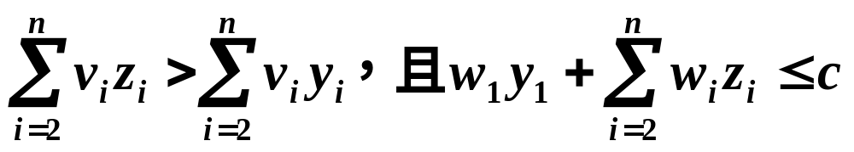
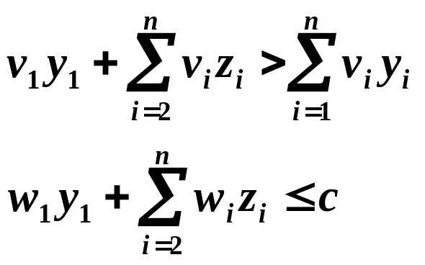


Proof:
If (z₂, ··· z_{n} ) is an optimal solution of the subproblem followed. (y₂, ··· y_{n}）is not the optimal one.
v_{i}x_{i}
x₁
Then
So
then (y₁,z₂, ··· z_{n} ) is better than (y₁, y₂,··· y_{n} ). So (y₁, y₂,··· y_{n} ) is not optimal solution, which is a contradiction.

Slide 50
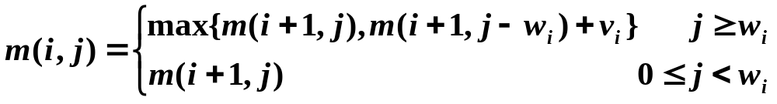
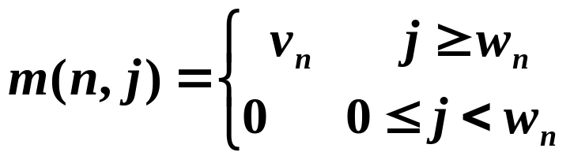
2. Build recursive formula
Suppose m( i, j ) is the optimal value of subproblem, in which capacity is j and optional items are i，i＋1，···, n.
  If select the ith item， 。
  If don’t select ith item, 。
  We can get the recursive formula as followed:
  m( i, j) = m(i + 1, j - wi) + vi
  m( i, j) = m(i + 1, j)

Slide 51
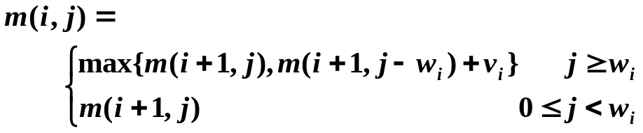
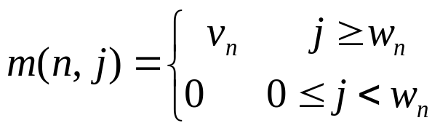
Example : there are four items. Bag capacity is 5. w[4]={2, 1, 3, 2}，v[4]={12, 10, 20, 15}. To compute m[1][c] and the solution
j
i
0
1
2
3
4
5
1
37
2
0
10
15
25
30
35
3
0
0
15
20
20
35
m[1][5]>m[2][5]
所以物品1被选
4
0
0
15
15
15
15
c – w[1]= 3,查看m[2][3]>m[3][3]
x₄ X₃ X₂ X₁
查看m[4][2]>0
1
0
1
1
j – w[2]= 2,查看m[3][2]=m[4][2]

Slide 52
3.Algorithm
template<class Type>
void Knapsack(Type v, int w, int c, int n, Type **m)
{
int jMax = min( w[n] - 1, c );
for( int j = 0; j <= jMax; j ++ )//出口
m[ n ][ j ] = ;
for( int j = w[n]; j <= c; j ++ )
m[ n ][ j ]= ;
for( int i = n - 1; i >1; i -- ) {
jMax = min( w[ i ] - 1, c );
for(int j = 0; j <= jMax; j ++)
m[ i ][ j ] = ;
for(int j = w[ i ]; j <= c; j ++)
m[ i ][ j ] = max( m[ i+1 ][ j ], m[ i+1 ][ j - w[ i ] ]+v[ i ]);
}
m[ 1 ][ c ] = ;
if( c >= w[1] )
m[1][c]=max(m[1][c],m[2][c-w[1]]+v[1]);
}
初始化m[n][j]
0
v[n]
m[ i+1 ][ j ]
m[ 2 ][ c ]
只剩下第一个物品时，如果剩余背包容积大于w1时，要进行选择

Slide 53
Constructing an optimal solution
j
i
0
1
2
3
4
5
4
0
0
15
15
15
15
3
0
0
15
20
20
35
2
0
10
10
25
30
35
1
37
m[1][5] <> m[2][5]
x[1]=1 c= 5- w[1]=3
m[2][3] <> m[3][3]
x[2]=1 c= 3- w[2]=2
m[3][2] = m[4][2]
x[3]=0 c= 2
m[4][2] <>0
x[4]=1

Slide 54
Constructing an optimal solution
Template<class Type>
Void Traceback(Type **m,int w,int c,int n,int x)
{
for(int i=1;i<n;i++)
if(m[i][c]==m[i+1][c])x[i]=0;
else{ x[i]=1;
c-=w[i];}
x[n]=(m[n][c])?1:0;
}

Slide 55
4.Time complexity
Time complexity of 0-1 knapsack is O(nc). It needs O(n) to construct optimal solution.
Shortcomings: the weights of every items should be integer. When c>2^{n}, time complexity will beΩ(n2^{n})
n=3, (w1, w2, w3)=(2, 3, 4), v1, v2, v3=(1, 2, 5), c=5

Slide 56
作业： 教材P82:3-4中(1)(2)
设有n种不同面值的硬币，各硬币的面值存于数组T[1:n]中。现要用这些面值的硬币来找钱。可以使用的各种面值的硬币个数不限。
(1)当只用硬币面值T[1], T[2], …,T[i]时，可找出钱数j的最少硬币个数记为C(i, j)。若只用这些硬币面值，找不出钱数j时，记C(i, j)=∞。给出C(i, j)的递归表达式及初始条件。1≤i ≤n, 1≤j ≤L。
(2) 设计一个动态规划算法，对1≤j ≤L，计算出所有的C(n,j)。算法中只允许使用一个长度为L的数组。用L和n作为变量来表示算法的计算时间复杂性。

Slide 57
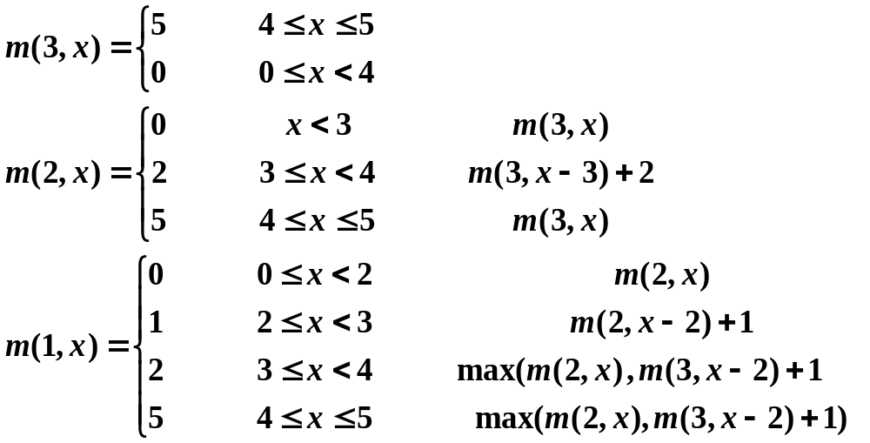
Extend to real number
For example，n=3, (w₁, w₂, w₃)=(2, 3, 4), v₁, v₂, v₃=(1, 2, 5), c=5

Slide 58
For every i(1≤i ≤n), m(i,j) is a stepwise monotonic non-reducing function for variable j , The jumping point is the descriptive feature of this function. For m(2,j) can be decided by(0,0)(3,2)(4,5)
(4,5)
(4,5)
(4,5)
(3,2)
(3,2)
(2,1)
(0,0)
(0,0)
(0,0)

Slide 59
When the variable j is a continuous variable, all the jump points of the function m(i, j) can be stored with a table p[i].
the value of the function m(i,j) can be determined by looking up the table p[i]

Slide 60
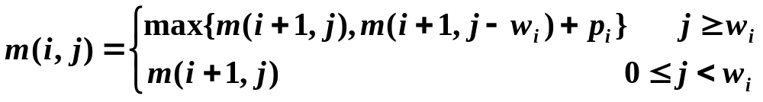
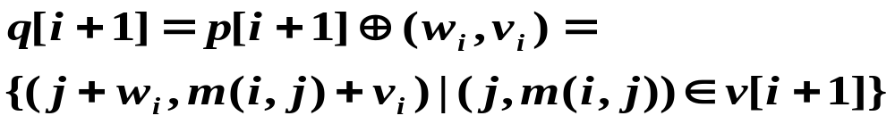
For
p[i] can be calculated recursively from p[i+1] .
p[n+1]={(0,0)}
All jump points of m(i,j) are included in the jump point set p[i+1] and the jump point set q of the function m(i+1,j-wi)+vi
q[i+1] is shifted by w_{i} units on the x-axis, and then moved up by v_{i} units by p[i+1].

Slide 61
Controlled jump point受控跳跃点
There are some points that do not meet the conditions.
Let (a,b)(c,d) be two jump points in p[i+1]Uq[i+1]. then when c≥a and d<b, (c,d) is controlled by (a, b), and thus (c, d) is not a jump point in p[i]

Slide 62
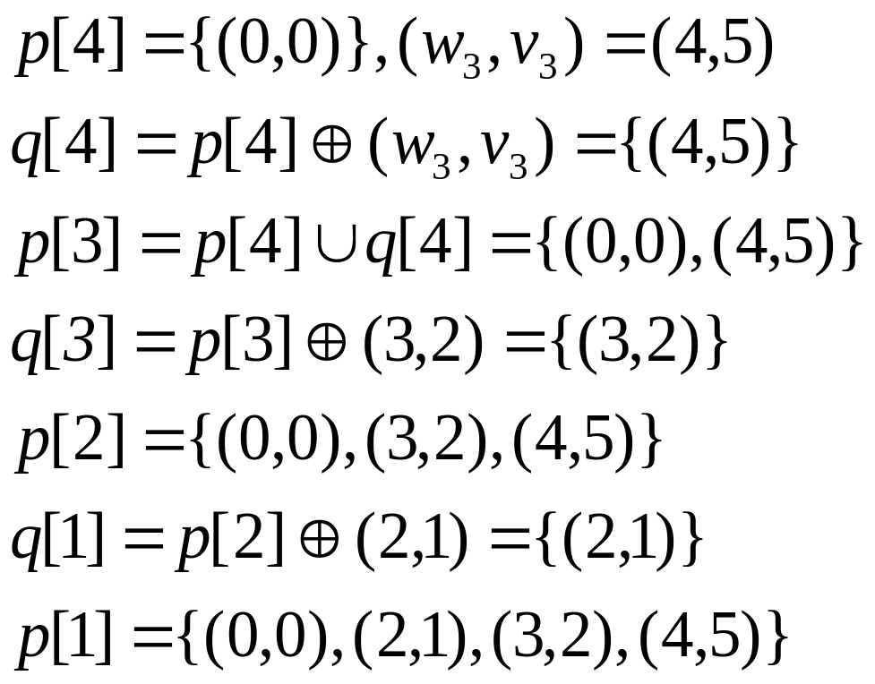
example
n=3, (w₁, w₂, w₃)=(2, 3, 4), v₁, v₂, v₃=(1, 2, 5), c=5

Slide 63
template<class Type>
Type Knapsack(int n,int c,Type v[],Type w[],Type **v, int x[])
{
int *head=new int[n+2];
head[n+1]=0;
p[0][0]=0;
p[0][1]=0;
int left=0;
right=0;
next=1;
head[n]=1;
for(int i=n;i>=1;i--){
int k=left;
for(int j=left;j<=right;j++){
if(p[j][0]+w[i]>c) break;
Type y=p[j][0]+w[i],
m=p[j][1]+v[i];
while(k<=right&&p[k][0]<y){
p[next][0]=p[k][0];
p[next++][1]=p[k++][1];
}
If(k<=right&&p[k][0]==y){
if(m<p[k][1]) m=p[k][1];
k++;
}
If(m>p[next-1][1]){
p[next][0]=y;
p[next++][1]=m;
}
while(k<=right&&p[k][1]<=p[next-1][1])k++;
}
while(k<=right) {
p[next][0]=p[k][0];
p[next++][1]=p[k++][1];
}
left=right+1;
right=next-1;
head[i-1]=next;
}
Traceback(n,w,v,p,head,x);
return p[next-1][1];
}

Slide 64
Construct optimal solution
template<class Type>
void Traceback(int n,Type w[ ],Type v[ ],Type**p,int *head,int x[ ])
{
Type j=p[head[0]-1][0],
m=p[head[0]-1][1];
for(int i=1;i<=n;i++){
x[i]=0;
for(int k=head[i+1];k<=head[i]-1;k++){
if(p[k][0]+w[i]==j&&p[k][1]+v[i]==m{
x[i]=1;
j=p[k][0];
m=p[k][1];
break;
}
}
}
}

Slide 65
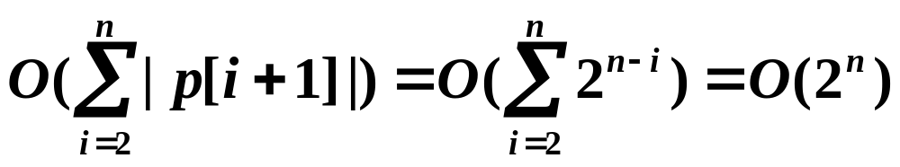
complexity
主要计算量在于计算跳跃点集p[i](1≤i≤n)。由于q[i+1]=p[i+1]⊕(w_{i},v_{i}),故计算q[i+1]需要O(|p[i+1]|)的计算时间。从跳跃点集p[i]的定义可以看出，p[i]中跳跃点个数不超过
2^{n-i+1}。由此计算跳跃点集所花费的计算时间为

Slide 66
3.4 Optimal Binary Search Trees最优二叉搜索树

Slide 67
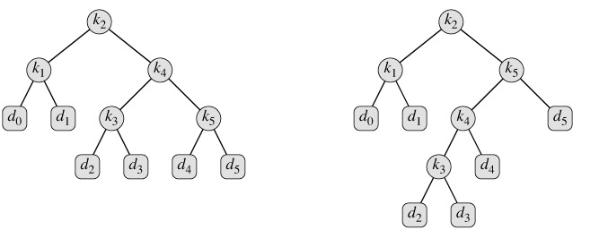
optimal binary search tree
Binary search tree
Optimal binary search tree

Slide 68
1 Binary search tree
the key in each node must be greater than all keys stored in the left sub-tree, and smaller than all keys in right sub-tree. (The leaves (final nodes) of the tree contain no key and have no structure to distinguish them from one another. Leaves are commonly represented by a special leaf or nil symbol, a NULL pointer, etc.)

Slide 69
1 binary search tree
xal
wan
zol
wil
yo
zom
wen
wim
xul
yum
xem
yon
zi
wul
Search: begin by examining the root node. If the tree is null, the key we are searching for does not exist in the tree. Otherwise, if the key equals that of the root, the search is successful and we return the node. If the key is less than that of the root, we search the left subtree. Similarly, if the key is greater than that of the root, we search the right subtree. This process is repeated until the key is found or the remaining subtree is null. If the searched key is not found before a null subtree is reached, then the item must not be present in the tree.

Slide 70
if
if
1binary search tree
for
while
for
repeat
repeat
loop
while
loop
a
b
different binary search tree has different perfomance
In a, we need 4 times comparations to find an identifier at worst. But in b, we need 3 times comparations.
they need 12/5 and 11/5 average comparitions respectively

Slide 71
2 optimal binary search tree
we are given a sequence K = 〈k₁, k₂, ..., k_{n}〉 of n distinct keys in sorted order.
For each key k_{i}, we have a probability p_{i} that a search will be for k_{i}.
Some searches may be for values not in K, and so we also have n + 1 "dummy keys" d₀, d₁, d₂, ..., d_{n} representing values not in K.
For each dummy key d_{i}, we have a probability q_{i} that a search will correspond to d_{i}.

Slide 72

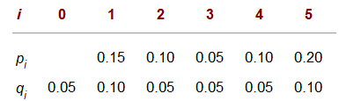

Slide 73
xal
wan
zol
wil
yo
zom
wen
wim
xul
yum
xem
yon
zi
wul
A
A代表其值处于wim和wul之间的可能关键码集合

Slide 74
Search for an element x in the binary search tree
Let S={x₁, x₂, ···, x_{n}} be an ordered set. x₁, x₂, ···, x_{n} denotes an ordered set of binary search trees：
  The element x is larger than the elements in its left subtree and less than the elements in its right subtress. The leaf vertices in the binary tree are open intervals of the form (x_{i}, x_{i+1})
(1) Found at the internal vertices of the binary tree ： x = x_{i}
(2) Found at the leaf nodes x∈ (x_{i} , x_{i+1})

Slide 75
different identifiers have different retrieval probabilities(检索概率).
最优二叉搜索树
Suppose p_{i} is the retrieval probabilities of a_{i}
q_{i} is the retrieval probabilities of identifiers which satisfied ai<X<ai+1,0≤i ≤ n (a₀=-∞ and a_{n+1}=＋∞)。
P(1)
P(2)
P(i)
P(i+1)
P(n)
E₀
a₁
E₁
a₂
a_{i}
E_{i}
a_{i+1}
a_{n}
E_{n}
Q(0)
Q(1)
Q(i)
Q(n)

Slide 76
最优二叉搜索树
最优二叉搜索树
利用动态规划构造对标识符集合
{a1, a2, …, an}的最优二叉搜索树算法包括成功检索和不成功检索）。

Slide 77
例 标识符集{1, 2, 3}＝{do, if, stop}可能的二分 检索树为
2
1
3
1
3
1
3
1
2
3
2
2
2
1
3
(c)
(d)
(a)
(b)
(e)
设每个内、外结点检索的概率相同：p_{i}=q_{i}=1/7
求每棵树的平均比较次数（成本）。
若P₁=0.5, P₂=0.1, P₃=0.05,
q₀=0.15, q₁=0.1, q₂=0.05, q₃=0.05求每棵树的平均比较次数（成本）。

Slide 78
例：
最优二叉搜索树
P₁=0.5, P₂=0.1, P₃=0.05, q₀=0.15, q₁=0.1, q₂=0.05, q₃=0.05
3
1
1
q₃
3
2
2
2
3
q₀
q₀
1
q₃
1
q₂
3
2
q₃
1
3
q₁
q₀
2
q₀
q₁
q₁
q₀
q₁
q₂
q₃
q₂
q₃
q₂
q₁
q₂
考虑平均搜索次数，也叫做平均路长
P_{a}(n)=1 × p₁ + 2 × p₂+3 × p₃ + 1×q₀ +2×q₁+ 3×( q₂ + q₃ )
=1 × 0.5+ 2 × 0.1+3 ×0.05 + 1×0.05 +2×0.1+ 3×( 0.05 + 0.05 )
=1.5

Slide 79
分析
最优二叉搜索树
对于图的内结点而言，第0层需要比较操作次数为1，第1层需要比较2次，第2层需要3次
P_{b}(n)=1 × p₁ + 2 × p₃+3 × p₂ + 1×q₀ + 3×( q₂ + q₃ )
=1 × 0.5+ 2 × 0.05 + 3 ×0.1 + 1×0.15 +2×0.05+ 3×( 0.05 + 0.05 )
=1.6
P_{c}(n)=1 × p₂ + 2 × (p₁ + p₃) + 2×(q₀ +q₁ +q₂ + q₃ )
=1 × 0.1+ 2 × (0.5 + 0.05) + 2×(0.15 + 0.1 + 0.05 + 0.05)
=1.9
P_{d}(n)=1 × p₃ + 2 × p₁+3 × p₂ + 1 × q₃+2 × q₀ +3 × (q₁+ q₂)
=1 × 0.05 + 2 × 0.5 + 3 × 0.1 + 1×0.05 + 2 × 0.15 + 3 × (0.1 + 0.05)
=2.15
P_{d}(n)=1 × p₃ + 2 × p₁+3 × p₂ + 1 × q₃+2 × q₀ +3 × (q₁ + q₂)
=1 × 0.05 + 2 × 0.5 + 3 × 0.1 + 1×0.05 + 2 × 0.15 + 3 × (0.1 + 0.05)
=2.15

Slide 80

最优二叉搜索树
找到元素x = x_{i}的概率为b_{i}；确定x∈ (x_{i} , x_{i+1})的概率为a_{i}。其中约定x₀= －∞ , x_{n+1}= + ∞ ,有

Slide 81

最优二叉搜索树
在一个表示S的二叉树T中，设存储元素x_{i}的结点深度为c_{i}；叶结点（x_{j}，x_{j＋1}）的结点深度为d_{j}
表示在二叉搜索树T中作一次搜索所需的平均比较次数。P又称为二叉搜索树T的平均路长，在一般情况下，不同的二叉搜索树的平均路长是不同的。

Slide 82
3、最优二叉搜索树问题
最优二叉搜索树问题
对于有序集S及其存取概率分布
（a₀, b₁, a₁, ···, b_{n}, a_{n}），在所有表示有序集S的二叉搜索树中找出一棵具有最小平均路长的二叉搜索树。
结点在二叉搜索树中的层次越深，需要比较的次数就越多，因此要构造一棵最小二叉树，一般尽量把搜索概率较高的结点放在较高的层次。

Slide 83
4、最优子结构性质
最优子结构性质
假设选择 k为树根，则 1, 2, …, k-1 和a₀, a₁, …, a_{k-1} 都将位于左子树 L 上，其余结点 (k+1, …, n 和 a_{k}, a_{k+1}, …, a_{n})位于右子树 R 上。
k
L
R
1, 2, …, k-1
a₀, a₁, …, a_{k-1}
k+1, …, n
a_{k}, a_{k+1}, …, a_{n}

Slide 84
最优子结构性质
51
14
72
06
33
53
97
13
25
43
64
84
99

Slide 85
最优子结构性质
51
14
72
06
33
53
97
13
25
43
64
84
99

Slide 86
最优子结构性质
设COST(L) 和COST(R) 分别是二分检索树T的左子树和右子树的成本
则检索树T的成本是：
P(k)+ COST(L) + COST(R)
若 T 是最优的，则上式及 COST(L) 和COST(R) 必定都取最小值。

Slide 87

4、最优子结构性质
最优子结构性质
二叉搜索树T 的一棵含有顶点x_{i} , ··· , x_{j}和叶顶点
(x_{i-1} , x_{i} ) , ··· , ( x_{j} , x_{j+1})的子树可以看作是有序集{ x_{i} , ··· , x_{j} }关于全集为 { x_{i-1} , x_{j＋1} }的一棵二叉搜索树（T 自身可以看作是有序集) 。根据S 的存取分布概率，在子树的顶点处被搜索到的概率是

Slide 88
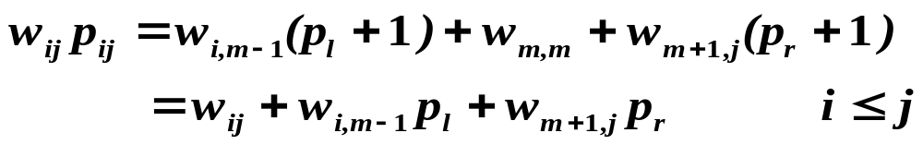
{x_{i} , ··· , xj}的存储概率分布为{a_{i-1}, b_{i}, …, b_{j}, a_{j} }，其中，a_{h}，b_{k}分别是下面的条件概率：
设Tij是有序集{x_{i} , ··· , x_{j}}关于存储概率分布为{a_{i-1}, b_{i}, …, b_{j}, a_{j} }的一棵最优二叉搜索树
P_{ij} ：平均路长
x_{m} ：T_{ij}的根顶点存储的元素
p_{l}和p_{r}: 左子树T_{l}和右子树T_{r}的平均路长
左子树的搜索概率
右子树的搜索概率

Slide 89
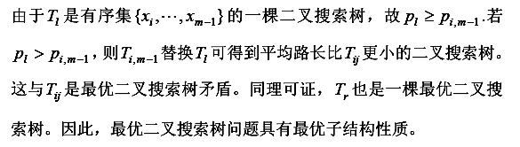
最优子结构性质
构造最优二叉搜索树时，可以选择先构造其左右子树，使其左右子树最优，然后构造整棵树

Slide 90
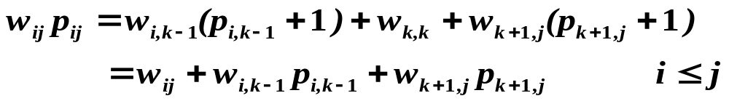

5、递归计算最优值
递归计算最优值
最优二叉搜索树T_{ij}的平均路长为p_{ij}，则所求的最优值为p_{1,n}。由二叉树的花费公式
根据最优二叉搜索树问题的最优子结构性质可建立计算p_{ij}的递归式如下
初始时

Slide 91




递归计算最优值
记w_{i,j} p_{i,j}为m( i, j )

Slide 92
根据该公式，计算树T[i][j]的花费只用到了T[i][k-1]，T[k+1][j], 可得到具体求解过程如下：
1）构造只有1个内部结点的最优二叉搜索树T[1][1],T[2][2]…, T[n][n]，可以求得m[i][i] 同时可以用一个数组存做根结点元素为：
s[1][1]=1, s[2][2]=2…s[n][n]=n
2) 构造具有2个内部结点的最优二叉搜索树

Slide 93
例
递归计算最优值
给出标识符集{1, 2, 3}＝{do, if, stop}存取概率
若P₁=0.5, P₂=0.1, P₃=0.05,
q₀=0.15, q₁=0.1, q₂=0.05, q₃=0.05
构造一棵最优二叉搜索树

Slide 94

P1=0.5, P2=0.1, P3=0.05, q0=0.15, q1=0.1, q2=0.05, q3=0.05
1
2
3
q0
q1
q1
q2
q2
q3
q0
q1
T[1][1]
w[1][1]=0.75
m[1][1]=0.75
T[2][2]
w[2][2]=0.25
m[2][2]=0.25
T[3][3]
w[3][3]=0.15
m[3][3]=0.15
T[1][0]
w[1][0]=0.15
m[1][0]=0
T[2][1]
w[2][1]=0.1
m[2][1]=0
1
2
q2
q3
q0
2
T[4][3]
w[4][3]=0.05
m[4][3]=0
1
q2
T[3][2]
w[3][2]=0.05
m[3][2]=0
q1
q2
q0
q1
T[1][2]
w[1][2]=0.9
m[1][2]=0.9+
m[1][0]+m[2][2]
=1.15
w[1][2]=0.9
m[1][2]=0.9+
m[1][1]+m[3][2]
=1.65

Slide 95
P1=0.5, P2=0.1, P3=0.05, q0=0.15, q1=0.1, q2=0.05, q3=0.05
1
2
3
q0
q1
q1
q2
q2
q3
T[1][1]
w[1][1]=0.75
m[1][1]=0.75
T[2][2]
w[2][2]=0.25
m[2][2]=0.25
T[3][3]
w[3][3]=0.15
m[3][3]=0.15
1
2
2
3
q0
2
q1
3
1
q2
2
q3
q1
q2
q0
q1
q2
q3
q1
q2
T[1][2]
T[2][3]
w[2][3]=0. 5
w[1][2]=0.9
m[1][2]=0.9+
m[1][0]+m[2][2]
=1.15
w[1][2]=0.9
m[1][2]=0.9+
m[1][1]+m[3][2]
=1.65
m[2][3]=0.5
m[2][3]=0.6

Slide 96
P1=0.5, P2=0.1, P3=0.05, q0=0.15, q1=0.1, q2=0.05, q3=0.05
1
2
3
q0
q1
q1
q2
q2
q3
T[1][1]
w[1][1]=0.75
m[1][1]=0.75
T[2][2]
w[2][2]=0.25
m[2][2]=0.25
T[3][3]
w[3][3]=0.15
m[3][3]=0.15
1
2
2
3
q0
2
q1
3
1
q2
2
q3
q1
q2
q0
q1
q2
q3
q1
q2
T[1][2]
T[2][3]
w[2][3]=0. 5
w[1][2]=0.9
m[1][2]=0.9+
m[1][0]+m[2][2]
=1.15
w[1][2]=0.9
m[1][2]=0.9+
m[1][1]+m[3][2]
=1.65
m[2][3]=0.5
m[2][3]=0.6

Slide 97
P1=0.5, P2=0.1, P3=0.05, q0=0.15, q1=0.1, q2=0.05, q3=0.05
1
2
q0
q1
3
2
q1
q2
q2
q3
T[1][2]
m[1][2]=1.15
T[2][3]
m[2][3]=0.5
1
3
2
2
1
3
1
q3
q0
q0
2
q1
3
q0
q1
q2
q3
T[1][3]
W[1][3]=1
q2
q3
q1
q2
m[1][3]=1.5
m[1][3]=1.9
m[1][3]=2.15

Slide 98
P1=0.5, P2=0.1, P3=0.05, q0=0.15, q1=0.1, q2=0.05, q3=0.05
1
2
q0
q1
3
2
q1
q2
q2
q3
T[1][2]
m[1][2]=1.15
T[2][3]
m[2][3]=0.5
1
3
2
2
1
3
1
q3
q0
q0
2
q1
3
q0
q1
q2
q3
T[1][3]
W[1][3]=1
q2
q3
q1
q2
m[1][3]=1.5
m[1][3]=1.9
m[1][3]=2.15

Slide 99
P1=0.5, P2=0.1, P3=0.05, q0=0.15, q1=0.1, q2=0.05, q3=0.05
0
1
2
3
0 1 2 3
1.15
1
0
0.75
1.5
1
2
3
4
0.15
0.75
0.9
1
2
0
0.25
0. 5
0.1
0.25
0.35
3
0
0.15
0.05
0.15
4
0
0.05
W(i, j)
m(i, j)
0 1 2 3
0
1
1
1
1
2
3
4
0
2
2
0
3
s(i, j)
0

Slide 100
具体求解过程
递归出口，没有内部节点时，构造T[1][0]
T[2][1],T[3][2]……，T[n+1][n]
2) 构造具有2个、3个、……、n个内部结点的最优二叉搜索树
r （ 起止下标的差）
0 T[1][1], T[2][2] , …， T[n][n]，
1 T[1][2], T[2][3], …，T[n-1][n]，
2 T[1][3], T[2][4], …，T[n-2][n]，
r T[1][r+1], T[2][r+2], …，T[i][i+r]，…，T[n-r][n]
n-1 T[1][n]

Slide 101
void OBST ( int a, int b,int n, int **m, int **s, int **w)
{
    for( int i=0; i<=n; i++){
      w[i+1][i]=a[i];
      m[i+1][i]=0;
      }//初始化，构造没有内部节点时的情况
    for(int r=0; r<n; r++)
    for(int i =1; i<=n-r; i++)
    {
    int j= j+r;
    构造T[i][j]，填写w[i][j],m[i][j],s[i][j]
    }
  }

Slide 102
构造T[i][j]
T[i][j]表示用第i到第j个内部节点构造的树，做根的结点可以是第i，i+1,…,j中任意一个。
1) 首选i作为根，其左子树空，右子树为结点i+1,i+2…j构成即T[i+1][j]。
m[i][j]=w[i][j]+0+m[i+1][j]
s[i][j]= i
2) 不选i做根，设k为其根，则k= i+1,…,j,左子树为结点i, i+1,…,k-1, 右子树为k+1, k+2, …,j
t= w[i][j]+m[i][k-1]+m[k+1][j]
if(t < m[i][j])
{ m[i][j]=t;
s[i][j]=k;
}
3)k= k+1, 跳回2

Slide 103
取第k个结点作根
void OptimalBinarySearchTree( int a, int b,int n, int **m, int **s, int **w)
{
for( int i=0; i<=n; i++){
w[i+1][i]=a[i];
m[i+1][i]=0;
}
for(int r=0; r<n; r++)
for(int i =1; i<= n - r; i++){
int j= j + r;
w[i][j]=w[i][j-1]+a[j]+b[j];
m[i][j]=m[i+1][j];
s[i][j] = i;
for(int k = i+1; k<=j; k++){
int t=m[i][k-1]+m[k+1][j];
if (t<m[i][j]){
m[i][j]=t;
s[i][j]=k;}
}
m[i][j]+=w[i][j];
}
}
初始化
对角线赋值
i为起始元素下标
j为终止元素下标
如第i个结点作根的值
加第j个结点后，权值w改变

Slide 104
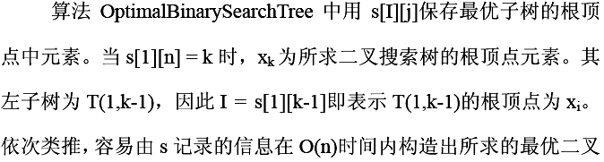
6、构造最优解

Slide 105
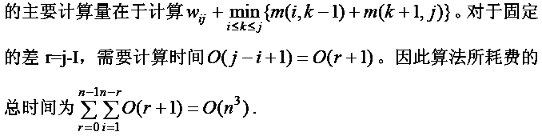
7、计算复杂性

Slide 106
练习
设n=4，且
(1, 2, 3, 4) = (do, if, read, while)。
又设b(1 : 4)=(3, 3, 1, 1)和a(0 : 4)=(2,3,1,1,1)
(这些b,a都乘了16。)
写出数组w[i][j],m[i][j],s[i][j]及最后的最优二叉搜索树

Slide 107
作业
P84 3-15

Slide 108
动态规划总结
一、动态规划的基本思想：
将问题分解为若干小问题，解子问题，然后从子问题得到原问题的解。

Slide 109
二、动态规划特点
将问题分解为子问题，这些子问题往往不相互独立。（如果可以用分治法求解，分解的子问题太多，因此，用分治法时间代价太高，消耗指数时间）

Slide 110
三、动态规划思路
如果能够保存已解决的子问题的答案，而在需要时再找出已求得的答案，这样就可以避免大量的重复计算，节省时间。
动态规划方法用一个表来记录所有已解的子问题的答案。不管该子问题以后是否被用到，只要它被计算过，就将其结果填入表中。这就是动态规划法的基本思路。具体的动态规划算法多种多样，但它们具有相同的填表格式。

Slide 111
四、动态规划问题的特征：
动态规划算法的有效性依赖于问题本身所具有的两个重要性质：最优子结构性质和子问题重叠性质。
1、最优子结构：当问题的最优解包含了其子问题的最优解时，称该问题具有最优子结构性质。
2、重叠子问题：在用递归算法自顶向下解问题时，每次产生的子问题并不总是新问题，有些子问题被反复计算多次。动态规划算法正是利用了这种子问题的重叠性质，对每一个子问题只解一次，而后将其解保存在一个表格中，在以后尽可能多地利用这些子问题的解。

Slide 112
五、应用
往往求解具有某种最优性质的问题，此类问题往往具有多个解，我们要找到具有最优值的那个解。

Slide 113
六、设计动态规划法的步骤：
1、找出最优解的性质，并刻画其结构特征；
2、递归地定义最优值（写出动态规划方程）；
3、以自底向上的方式计算出最优值；
4、根据计算最优值时得到的信息，构造一个最优解。
步骤1-3是动态规划算法的基本步骤。在只需要求出最优值的情形，步骤4可以省略，步骤3中记录的信息也较少；若需要求出问题的一个最优解，则必须执行步骤4，步骤3中记录的信息必须足够多以便构造最优解。

